Slide 1
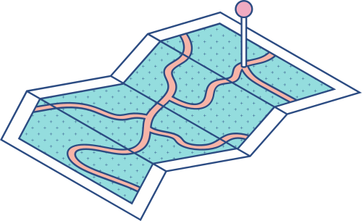





IT346 – SUMMER INTERNSHIP - I
Process Overview of
IT Operations
A Traineeship based on Network Administration and Site Reliablity
Prepared by:
Mit Parmar (21IT104)

Slide 2

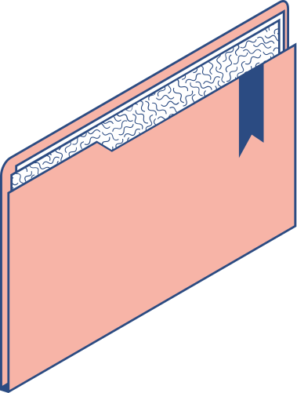

Key Notes
KEY TOPICS DISCUSSED IN THIS PRESENTATION
Introduction Overview IT Infrastructure Securing the Data SAP: aka Asset management solution Server room Helpdesk Conclusion Key Takeaways

Slide 3

Introduction
I had the opportunity to explore various aspects of IT operations in a manufacturing environment.
The knowledge and understanding I gained during this experience have enabled me to delve into critical topics related to IT infrastructure, network management, data security, and more.
Let's dive into the fascinating world of IT operations in a manufacturing unit and discover the key elements that contribute to the efficient functioning of such an environment.

Slide 4

Overview of IT operations at TCL
At Tata Chemicals Limited, IT operations are essential for optimizing manufacturing processes.
Key aspects include:
Infrastructure Management: Handling hardware and servers.
Network Connectivity: Ensuring seamless communication.
Automation and Robotics: Enhancing production efficiency.
Data Management: Efficient storage and retrieval.
Cybersecurity: Protecting against threats.
ERP and Business Systems: Streamlining operations.
Helpdesk and Support: Addressing technical issues promptly.
IT's critical role drives efficiency and productivity, making it a cornerstone of successful manufacturing operations.

Slide 5


Industrial Safety and SOPS
Getting training on industrial safety and SOPs at Tata Chemicals Limited.
Emphasized the importance of PPE and entry protocols.
Learned emergency procedures and hazardous material handling.
Safety officers' role in enforcing safety standards.

Slide 6

Networking Hardwares
AKA: The nervous system
Enhanced Connectivity: Facilitates seamless communication and real-time data exchange between departments, boosting productivity.
Efficient Resource Sharing: Enables shared access to resources like printers and servers, optimizing resource utilization.
Centralized Data Management: Facilitates centralized data storage and retrieval, ensuring secure and quick access to vital information.
Process Automation and Monitoring: Supports automation systems for remote monitoring and adjustments, increasing efficiency.

Slide 7
Cablings used at the unit
Ethernet (Cat5e/Cat6):
High-speed data transfer (up to 1Gbps) over short distances.
Ideal for connecting computers and printers.
Fiber Optic:
Ultra-high-speed data transmission over longer distances.
Used for data centers and backbone connections.
Coaxial:
Suitable for data and video transmission in manufacturing systems.
Used for CCTV cameras and security systems.
Twisted Pair (STP/UTP):
Reliable and cost-effective.
STP offers better noise resistance, UTP for general LAN connections.
PVC Cables:
PVC cables for non-plenum areas

Slide 8
Securing the Data Assets
Considering Importance of Data Security in a Manufacturing Unit:
Protects Sensitive Information: Data security safeguards critical production data, intellectual property, and customer information from unauthorized access and theft.
Ensures Compliance: Compliance with data protection regulations, such as GDPR or industry-specific standards, is crucial to avoid legal consequences.
Preserves Reputation: Robust data security measures build trust with customers, partners, and stakeholders, preserving the company's reputation.

Slide 9


Data Security Measures
Access Controls:
Implement strict access controls to limit data access only to authorized personnel.
Use strong passwords, multi-factor authentication, and role-based access to minimize vulnerabilities.
Encryption:
Encrypt sensitive data both in transit and at rest to prevent unauthorized interception or tampering.
Secure data through encryption algorithms and key management practices.
Regular Backups:
Conduct regular data backups to ensure data availability in case of hardware failures or cyberattacks.
Store backups securely to prevent data loss.

Slide 10
Data Security Measures
Network Security:
Employ firewalls, intrusion detection/prevention systems, and antivirus software to protect the network from external threats.
Regularly update and patch security software to stay ahead of vulnerabilities.
Secure File Sharing:
Use secure file sharing platforms and protocols to prevent data leaks and unauthorized access.
Monitor file transfers and restrict access to sensitive data.
Incident Response Plan:
Develop an incident response plan to promptly address security breaches or data incidents.
Define roles and responsibilities for handling data breaches and recovering from attacks.

Slide 11

The SAP Net Weaver Application Server
What is SAP Net Weaver Application Server?
SAP Net Weaver Application Server is a technology platform developed by SAP, a leading enterprise software company.
It serves as the foundation for various SAP applications and solutions, providing a robust and scalable infrastructure for businesses.

Slide 12
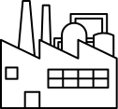
SAP use case at TCL
SAP Net Weaver Application Server plays a crucial role in the manufacturing industry, streamlining and optimizing various processes.
Integration and Centralization: It enables seamless integration between different departments, promoting data centralization and enhancing collaboration.
ERP Solutions: SAP Net Weaver supports Enterprise Resource Planning (ERP) solutions, providing a comprehensive view of manufacturing operations, including procurement, production, and inventory management.

Slide 13
SAP use case at TCL (Contd.)
Business Intelligence: The platform offers powerful business intelligence capabilities, facilitating data analysis and informed decision-making in the manufacturing environment.
Supply Chain Management: SAP Net Weaver helps in managing the supply chain efficiently, from raw material procurement to product distribution, ensuring smooth operations.
Manufacturing Execution: It supports Manufacturing Execution Systems (MES), enabling real-time monitoring and control of production processes.
Asset Management: SAP Net Weaver aids in asset management, ensuring equipment maintenance, and minimizing downtime for enhanced productivity.

Slide 14
Overview of Server Room Setup
Significance of a Server Room:
Central hub for managing IT operations in manufacturing.
Ensures data storage, system reliability, and uptime.
Provides data security, access control, and disaster recovery.
Facilitates seamless network connectivity.

Slide 15
Overview of Server Room Setup
Key Components:
Servers: Host critical manufacturing applications.
Data Storage: Centralized storage for manufacturing data.
Networking Equipment: Enables communication within and outside the unit.
Power Management: UPS for uninterrupted operation.
Cooling Solutions: Maintains optimal temperature and humidity.
Security Measures: Protects against unauthorized access.
Cable Management: Organized cabling infrastructure.
Monitoring Tools: Real-time performance monitoring.

Slide 16
Role of the Helpdesk at Giant Manufacturing unit like TCL
The helpdesk serves as the frontline support for IT operations.
It acts as a single point of contact for employees' IT-related queries and issues.
Provides timely resolution to technical problems, ensuring smooth manufacturing processes.
Offers assistance in using various IT systems and software applications.
Collaborates with other IT teams to address complex issues.

Slide 17
Role of the Helpdesk at Giant Manufacturing unit like TCL
Software Installation and Updates: Assisting with software installations and updates on employees' devices.
Security Concerns: Guiding users on best practices for data security and addressing potential security breaches.
Mobile Device Support: Helping employees with mobile device setup, configuration, and troubleshooting.
Hardware Problems: Troubleshooting and resolving issues with computers, printers, scanners, and other hardware devices used in manufacturing.
Software Glitches: Assisting employees with software errors, application crashes, and compatibility issues.
Network Connectivity: Resolving network-related problems, such as internet access, network printing, and Wi-Fi connectivity.

Slide 18
Conclusion
Engaging Work Environment: Dynamic atmosphere within the manufacturing unit at Tata Chemicals Limited.
IT Operations Exposure: Valuable insights into technology's role in enhancing manufacturing processes.
Hands-On Learning: Deeper understanding of server room setups, IT support, and network management.
Collaborative Teamwork: Witnessed collective efforts driving success in a large organization.
Problem-Solving Challenges: Tested and improved problem-solving skills through IT issue handling.
Data Security Emphasis: Emphasized the importance of safeguarding sensitive manufacturing data.
IT Automation & Efficiency: Inspired innovative approaches through the power of IT automation.

Slide 19

Key Takeaways
Enhanced Technical Skills: Improved proficiency in IT operations, troubleshooting, and software management.
Professional Networking: Established valuable connections with industry professionals and colleagues.
Real-World Application: Practical experience deepened my understanding of IT concepts in a manufacturing context.
Adaptability & Resilience: Learned to adapt to dynamic situations and handle challenges with resilience.
Industry Insights: Gained valuable insights into the manufacturing industry and its reliance on IT solutions.

Slide 20


